Slide 1

Arabic Handwriting Recognition
Thomas Taylor

Slide 2
Roadmap
Introduction to Handwriting Recognition
Introduction to Arabic Language
Challenges of Recognition
Recognition Stages
Conclusion

Slide 3
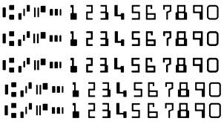
Introduction
On-line vs Off-line
Closed Dictionary vs Open Dictionary
Uses: Signature Verification, Check Processing, Postal Address Verification, Form validation etc.
Notes:
On-line – digitizer sample (writing on a screen) – time information is displayed with it
Off-line – typically something from a scanner
Closed Dictionary – recognition of words from a predefined dictionary
Open Dictionary – recognizing words without constraint

Slide 4
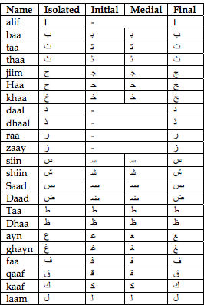

Arabic Language
Right-to-left
28 Letters
Letter Positions
One Case

Slide 5
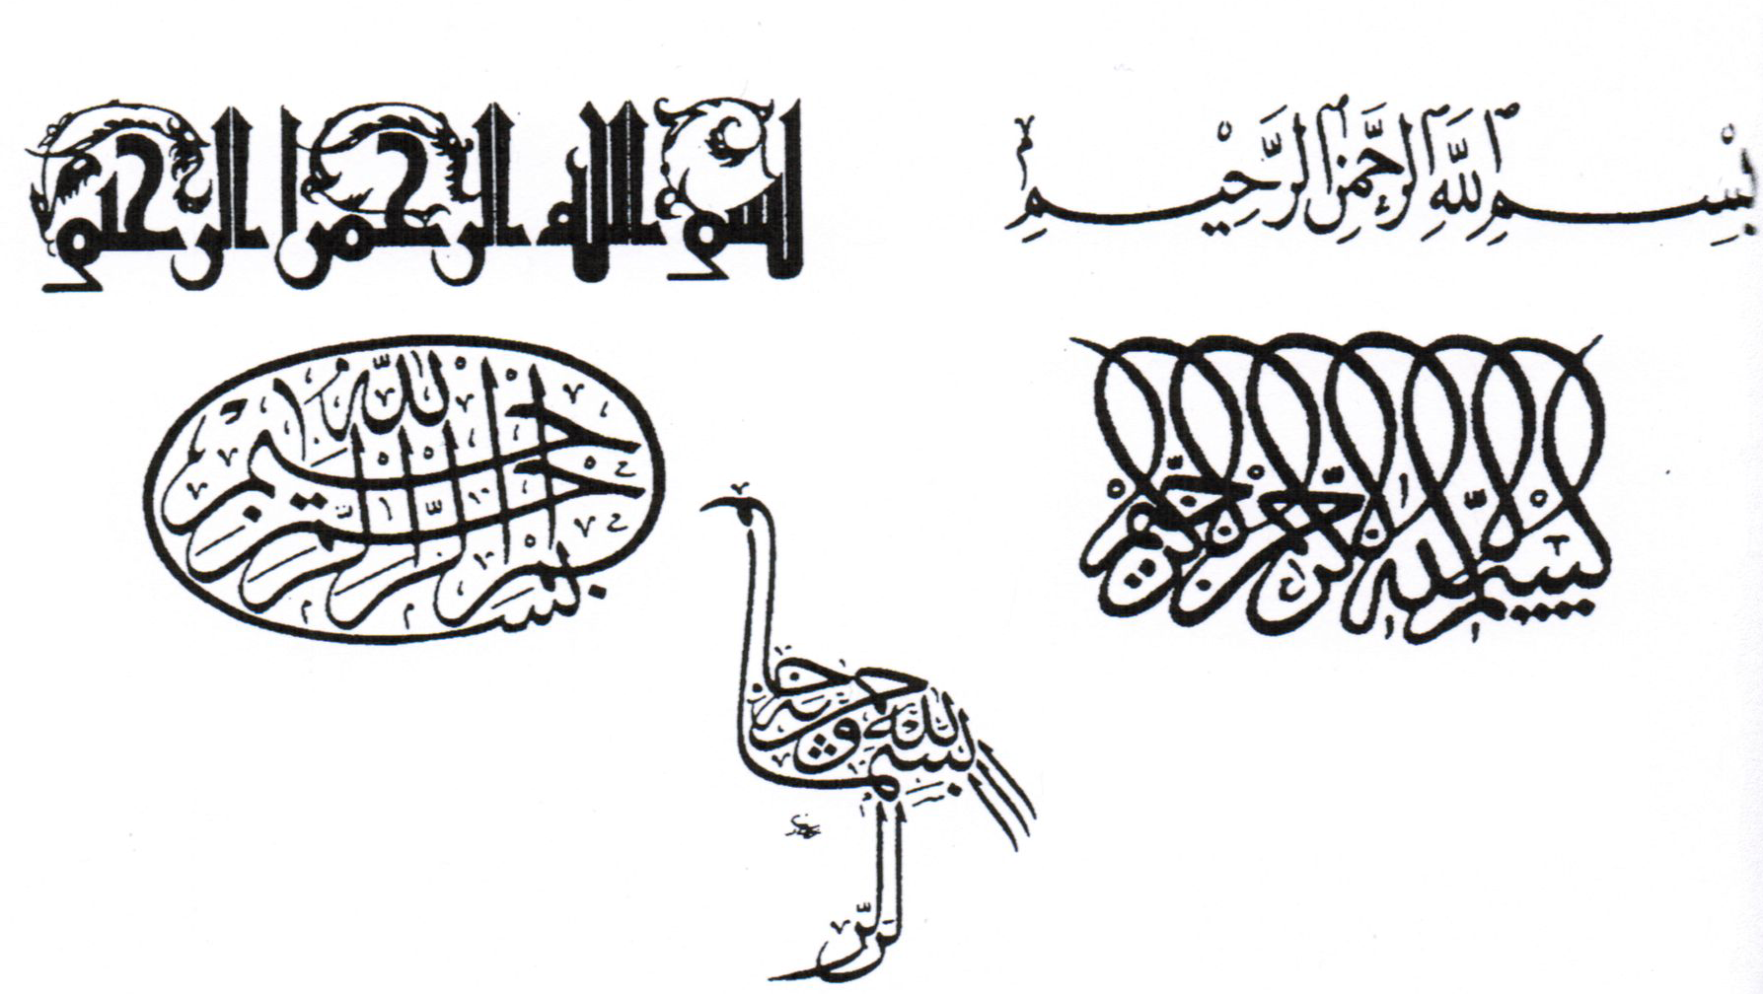
Challenges of Recognition
Short Vowels
Handwriting Styles
“PAWs”
“ligatures”
Notes:
“Pieces of Arabic words” (talib)
“ligatures” – laam alif, laam-miim

Slide 6
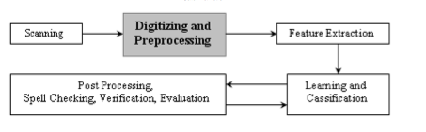
Recognition Approaches

Slide 7

Pre-Processing / Representation
Binarization
Skeletonization
Hit Miss image processing algorithm
Detection of the baseline
Graph of word
1993 – writing order of strokes
2003 – letter boundaries + skeleton
Notes:
Binarization – convert image into Binary Image
NOISE REDUCTION
Skeleton – one pixel thick representation of handwriting
Baseline – see notes, slant/slope normalization
1993 – restore writing order of strokes to offline words – line segments fit to thinned words ordering hypostesised by knowledge of how arabic written 92% success

Slide 8


Skeltonization
Step 1: search noises and remove them, applying the templates for noise removing.
Step 2: For each pixel from left to right:
if the template is not in the set of Connective templates and is not in the set of end point templates.
apply hit-miss operation using templates 2, 4
Step 3: For each pixel from up to down :
If the template is not in the set of Connective templates and is not in the end point templates.
apply hit-miss operation using templates 1,3
Algorithm from “Preprocessing phase for Arabic Word Handwritten Recognition“

Slide 9
Segmentation
Words into characters, strokes, or other unites
Uses holistic rules to break apart Arabic cursive
Horizontal/vertical projections
Texts upper contour

Slide 10

Structural Features / Featured Extraction
Primary shapes shared – number of dots alters letter
Stems – 2 main Arabic types
Legs
Used on words or individual letters
Notes:
More commonly used in arabic vs latin script handwriting recognition – more prominent
Dots, loops, pixel density, branch points, endpoints,
Stems – alif kaf

Slide 11
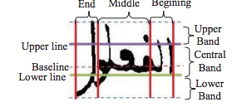
Stem / Leg Extraction
Stem
Leg
1. Extract components in the upper band.
2. For each component compute the Ratio (C) of height and width
3. if Ratio(C)>1 then compute number of run length pixels
if number of run length pixels<4 then return stem alif else return stem kef
1. Extract components in lower band
2. Compute contact points with lower line if contact points = 1 compute position relative to middle of letter if to right = “Raa” else = “Haa”
If contact points <= 3 stem is a noun
Else compute pixel discontinuity
Discontinuity is right “Raa”
Else “Haa”

Slide 12
Recognizer Methodologies
Recognizer engines
Artificial Neural Networks
Shape, symmetry, closed/open areas, pixels
Hidden Markov Models
States and probabilities
“Holistic” vs Segment Based
Notes:
Recognizer engines are rule based, probabilistic, or combined. Take all information gathered/stripped from the previous stages and makes a decision
ANN – feature properties (topographical) separated and assigned a numerical value
Set of numerical values of all properties used to identify character against a vector database.
Hidden Markov Models – One dimensional sequence of data containing states and probs based upon observances. Observations could be set of pixel values and states parts of letters
Holistic – whole word processed
Segment – whole/partial characters individually

Slide 13
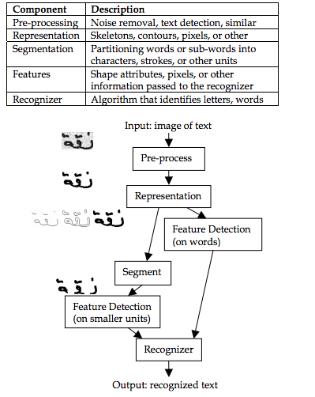
Overview

Slide 14
Machine-Print Recognition
Recognizing typed Arabic – 85-90% success rate
Early focus
No commercial off-line Arabic handwriting recognition software exists.
Notes:
1981 OpticalCharacterRecognition news paper headlines
Challenges in different fonts – disconnected font would help OCR tremendously (bring it to Chinese/latin)
Machine print uses a lot of same aspects discussed earlier
Nowadays several commercial OCR products – ciyasoft, novodynamics

Slide 15
Databases
Arabic databases catching up to those of Latin Script
Checks
“Indian Digits”
Notes:
City names, state names, zip codes
Indian digits used in Arabic writing.
Institute of Communications Technology (ICT) and ENIT in Tunisia – about 26,000+ images of towns names in tunisa (900 town names) 411 different writers

Slide 16
Conclusion
Intro to Handwriting Recognition
Intro to Arabic Language
Challenges
Stages of Recognition

Slide 17

Questions

Slide 18
References
Al-Rashaideh, H. (2006). Preprocessing phase for Arabic Word Handwritten Recognition.
Kacem, A. A., Nadia; Belaid, Abdel. (2012). Structural Features Extraction for Handwritten Arabic Personal Names Recognition. Frontiers in Handwriting Recognition (ICFHR), 268-273. doi: 10.1109
Lorigo, L. M., & Govindaraju, V. (2006). Offline Arabic Handwriting Recognition: A Survey. IEEE Trans. Pattern Anal. Mach. Intell., 28(5), 712-724. doi: 10.1109/tpami.2006.102
Shrivastava, V. S., Navdeep. (2012). ARTIFICIAL NEURAL NETWORK BASED OPTICAL CHARACTER RECOGNITION. Signal & Image Processing : An International Journal (SIPIJ) 3(5), 7.
Shu, H. (1996). On-Line handwriting using Hidden Markov Models.

